Slide 1
Cybersecurity Metrics What Good Looks Like ISSA 2022
www.Bayuk.com
Copyright 2020 Jennifer : Bayuk LLC

Slide 2
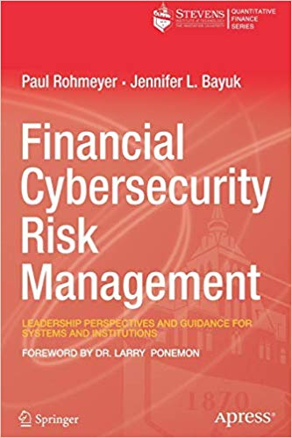
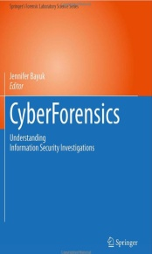
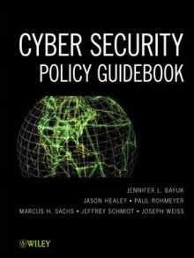
Jennifer Bayuk
Experienced in a wide variety of private security positions, including Wall Street Chief Information Security Officer, Financial Services Internal Audit, Global Bank Operational Risk Management, and Big 4 Information Systems Risk
Created curriculum for numerous information security, cybersecurity, and technology risk topics for conferences, seminars, corporate training, and graduate-level academic programs
Frequent contributor to Cybersecurity Committees educational forums.
BS in Computer Science and Philosophy, MS in Computer Science, PhD in Systems Engineering. Adjunct Professor of Cybersecurity.
Author of multiple textbooks and articles on security management topics.
Many publications available for download at: www.bayuk.com

Slide 3
Overview
Good metrics require a measurable underlying cybersecurity program. Industrial engineers intuitively understand that business critical processes must be instrumented for measurement in order to be successfully managed. Cybersecurity practitioners often try to skip this instrumentation step in aggressive pursuit of protection.
Discussion of this topic includes:
“Good” Criteria
Asset Inventory, including Technology Devices
Threat-based Risk Register
Cybersecurity Architecture
Cybersecurity Control Inventory
Cybersecurity Operations
Issue Register
Specifications and Algorithms

Slide 4
Landscape Attributes
A landscape is the visible features of an area of land, its landforms, and how they integrate with each other.
Depending on where you are standing within a landscape, it will look different because different features will be visible.
Example Landscape: Yosemite Valley
Example Feature: Yosemite Falls

Slide 5
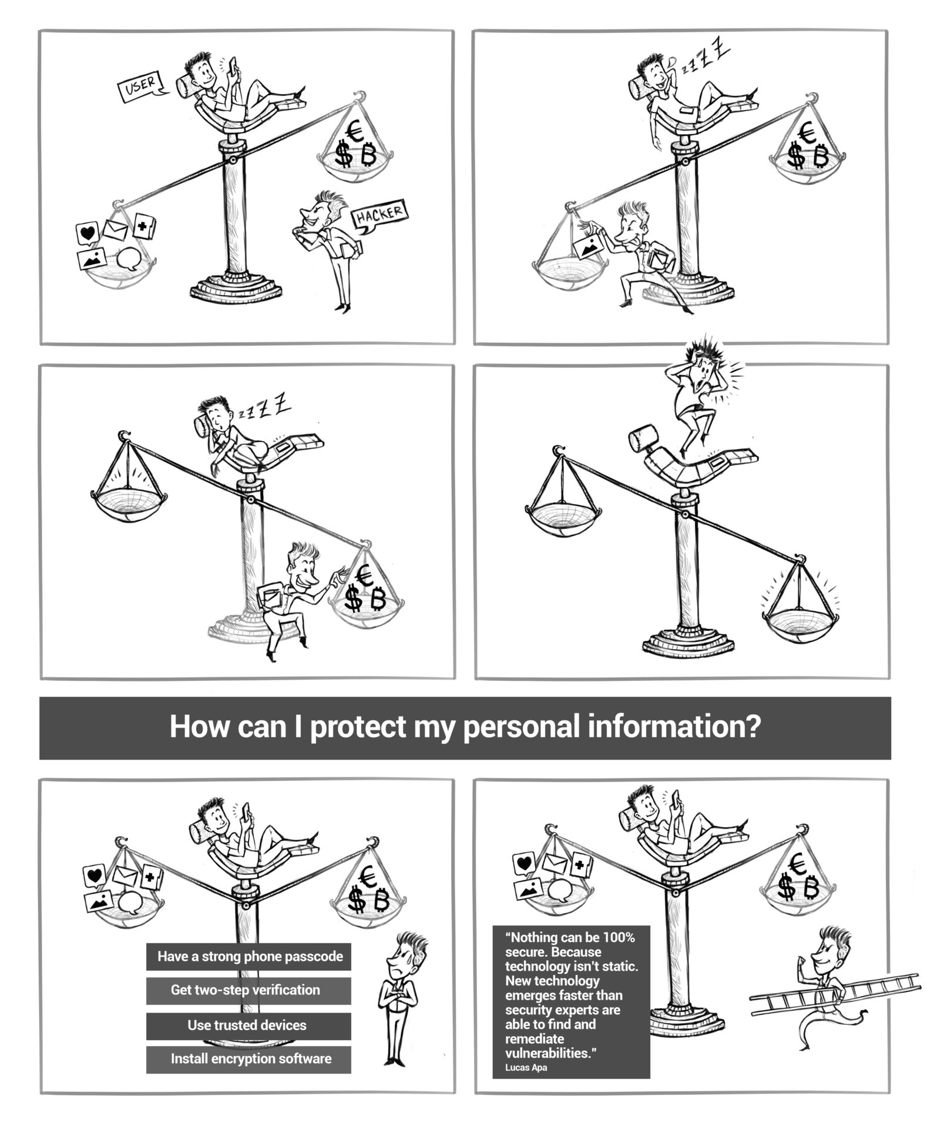
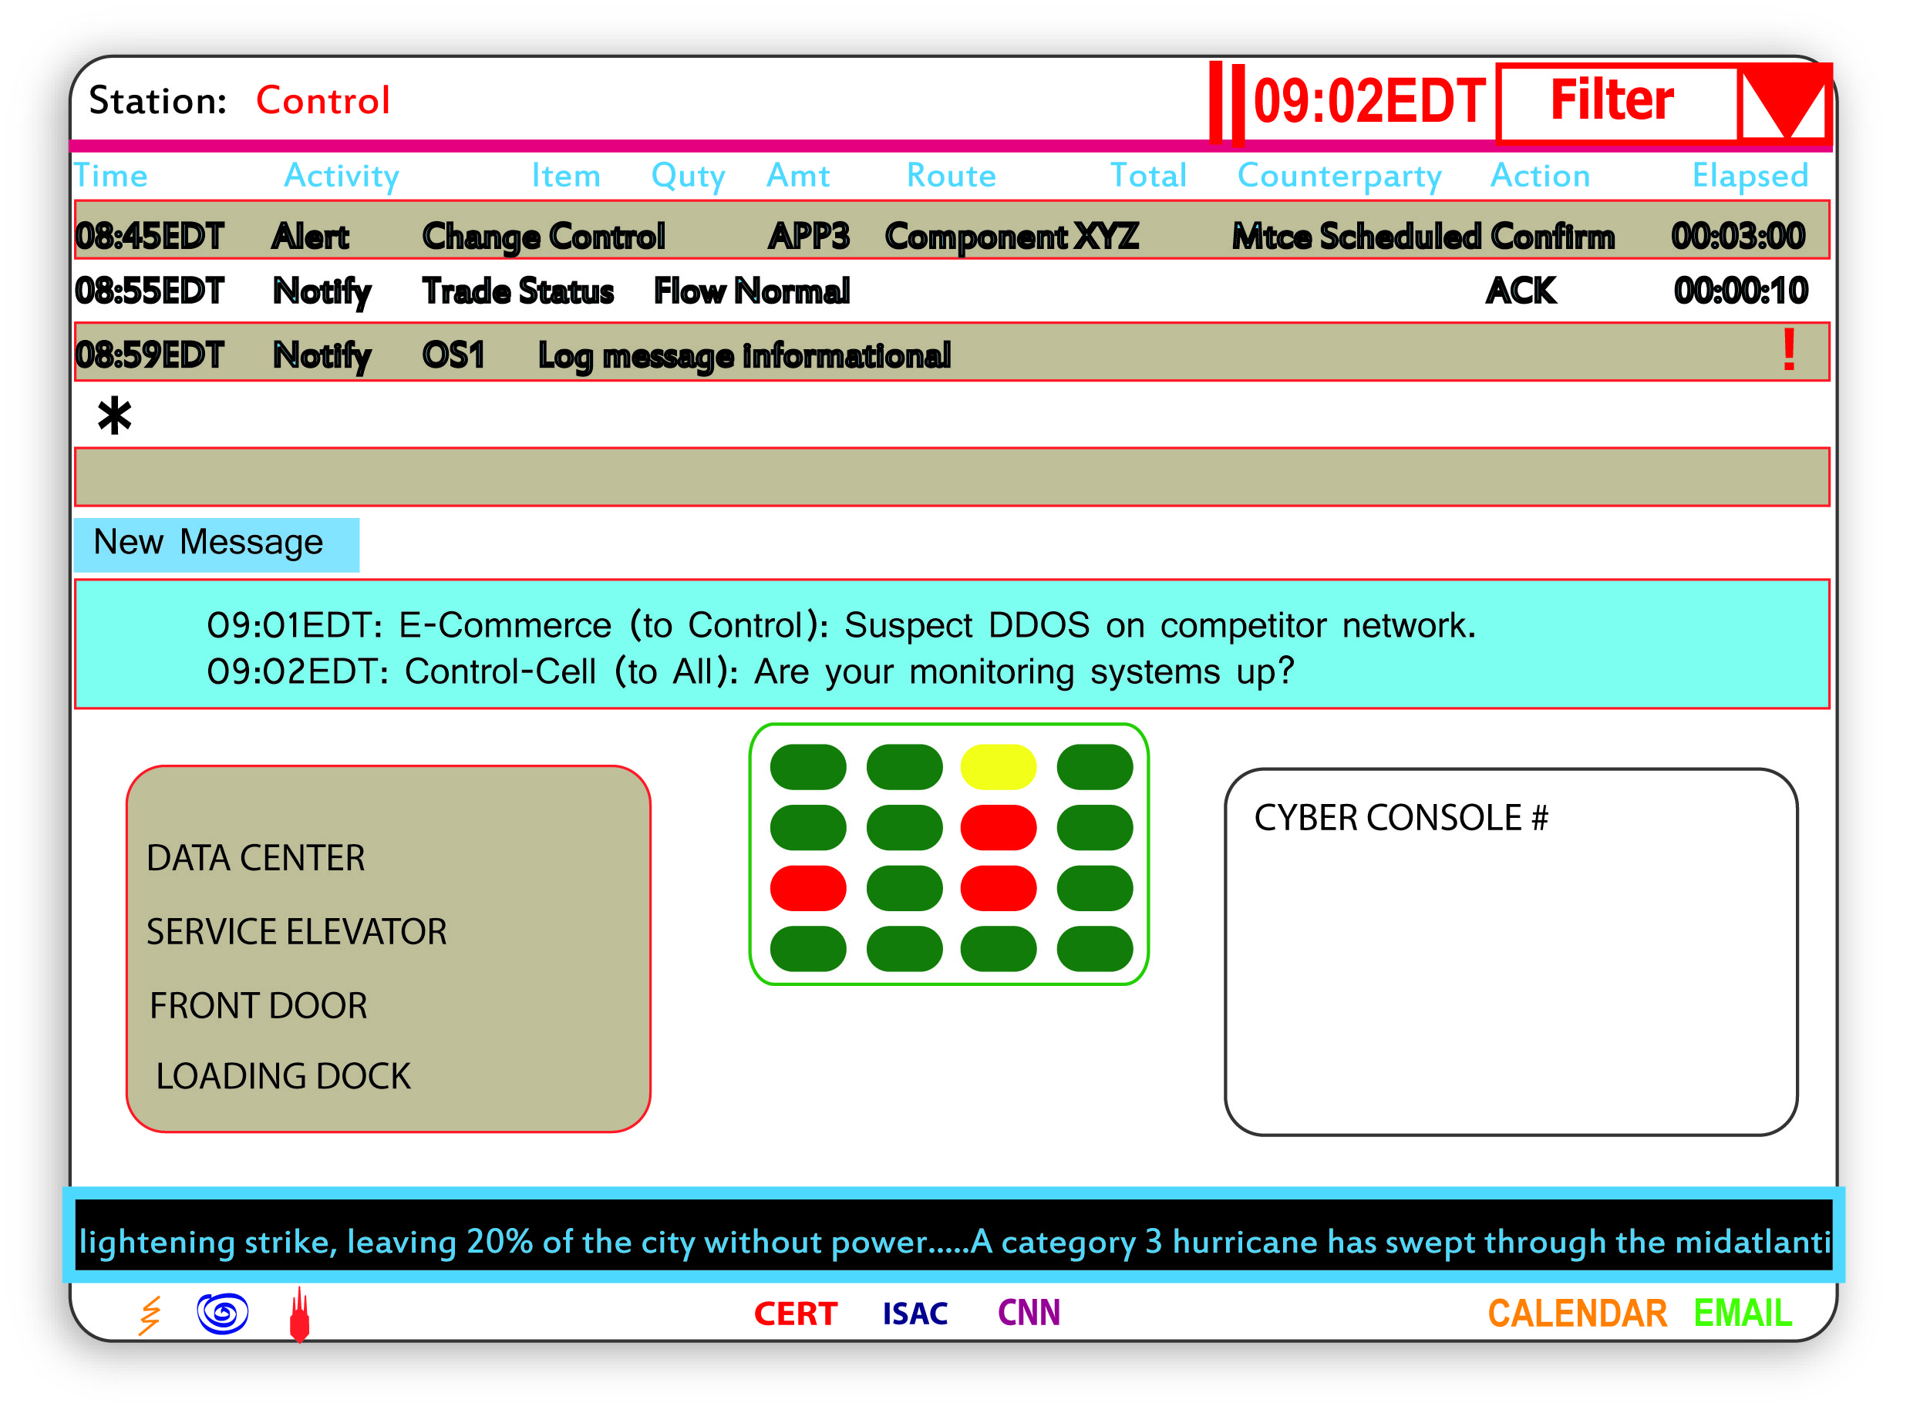
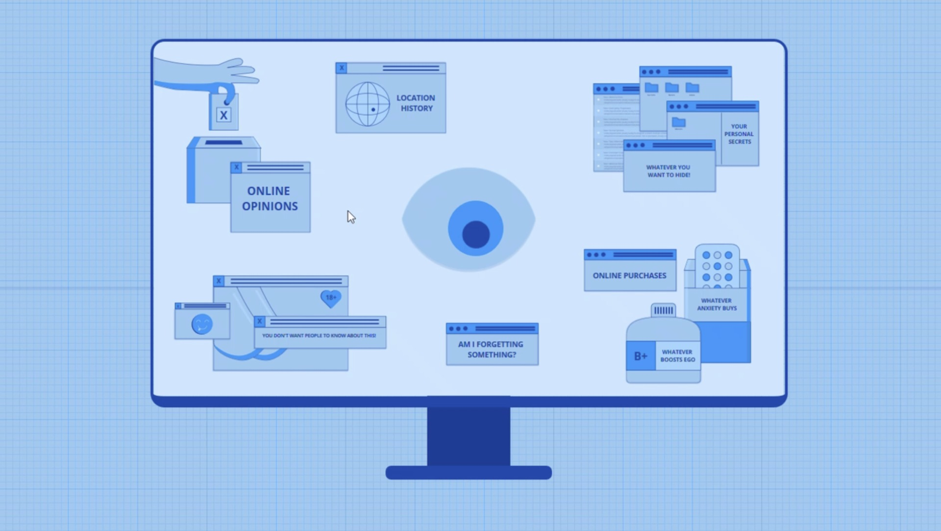
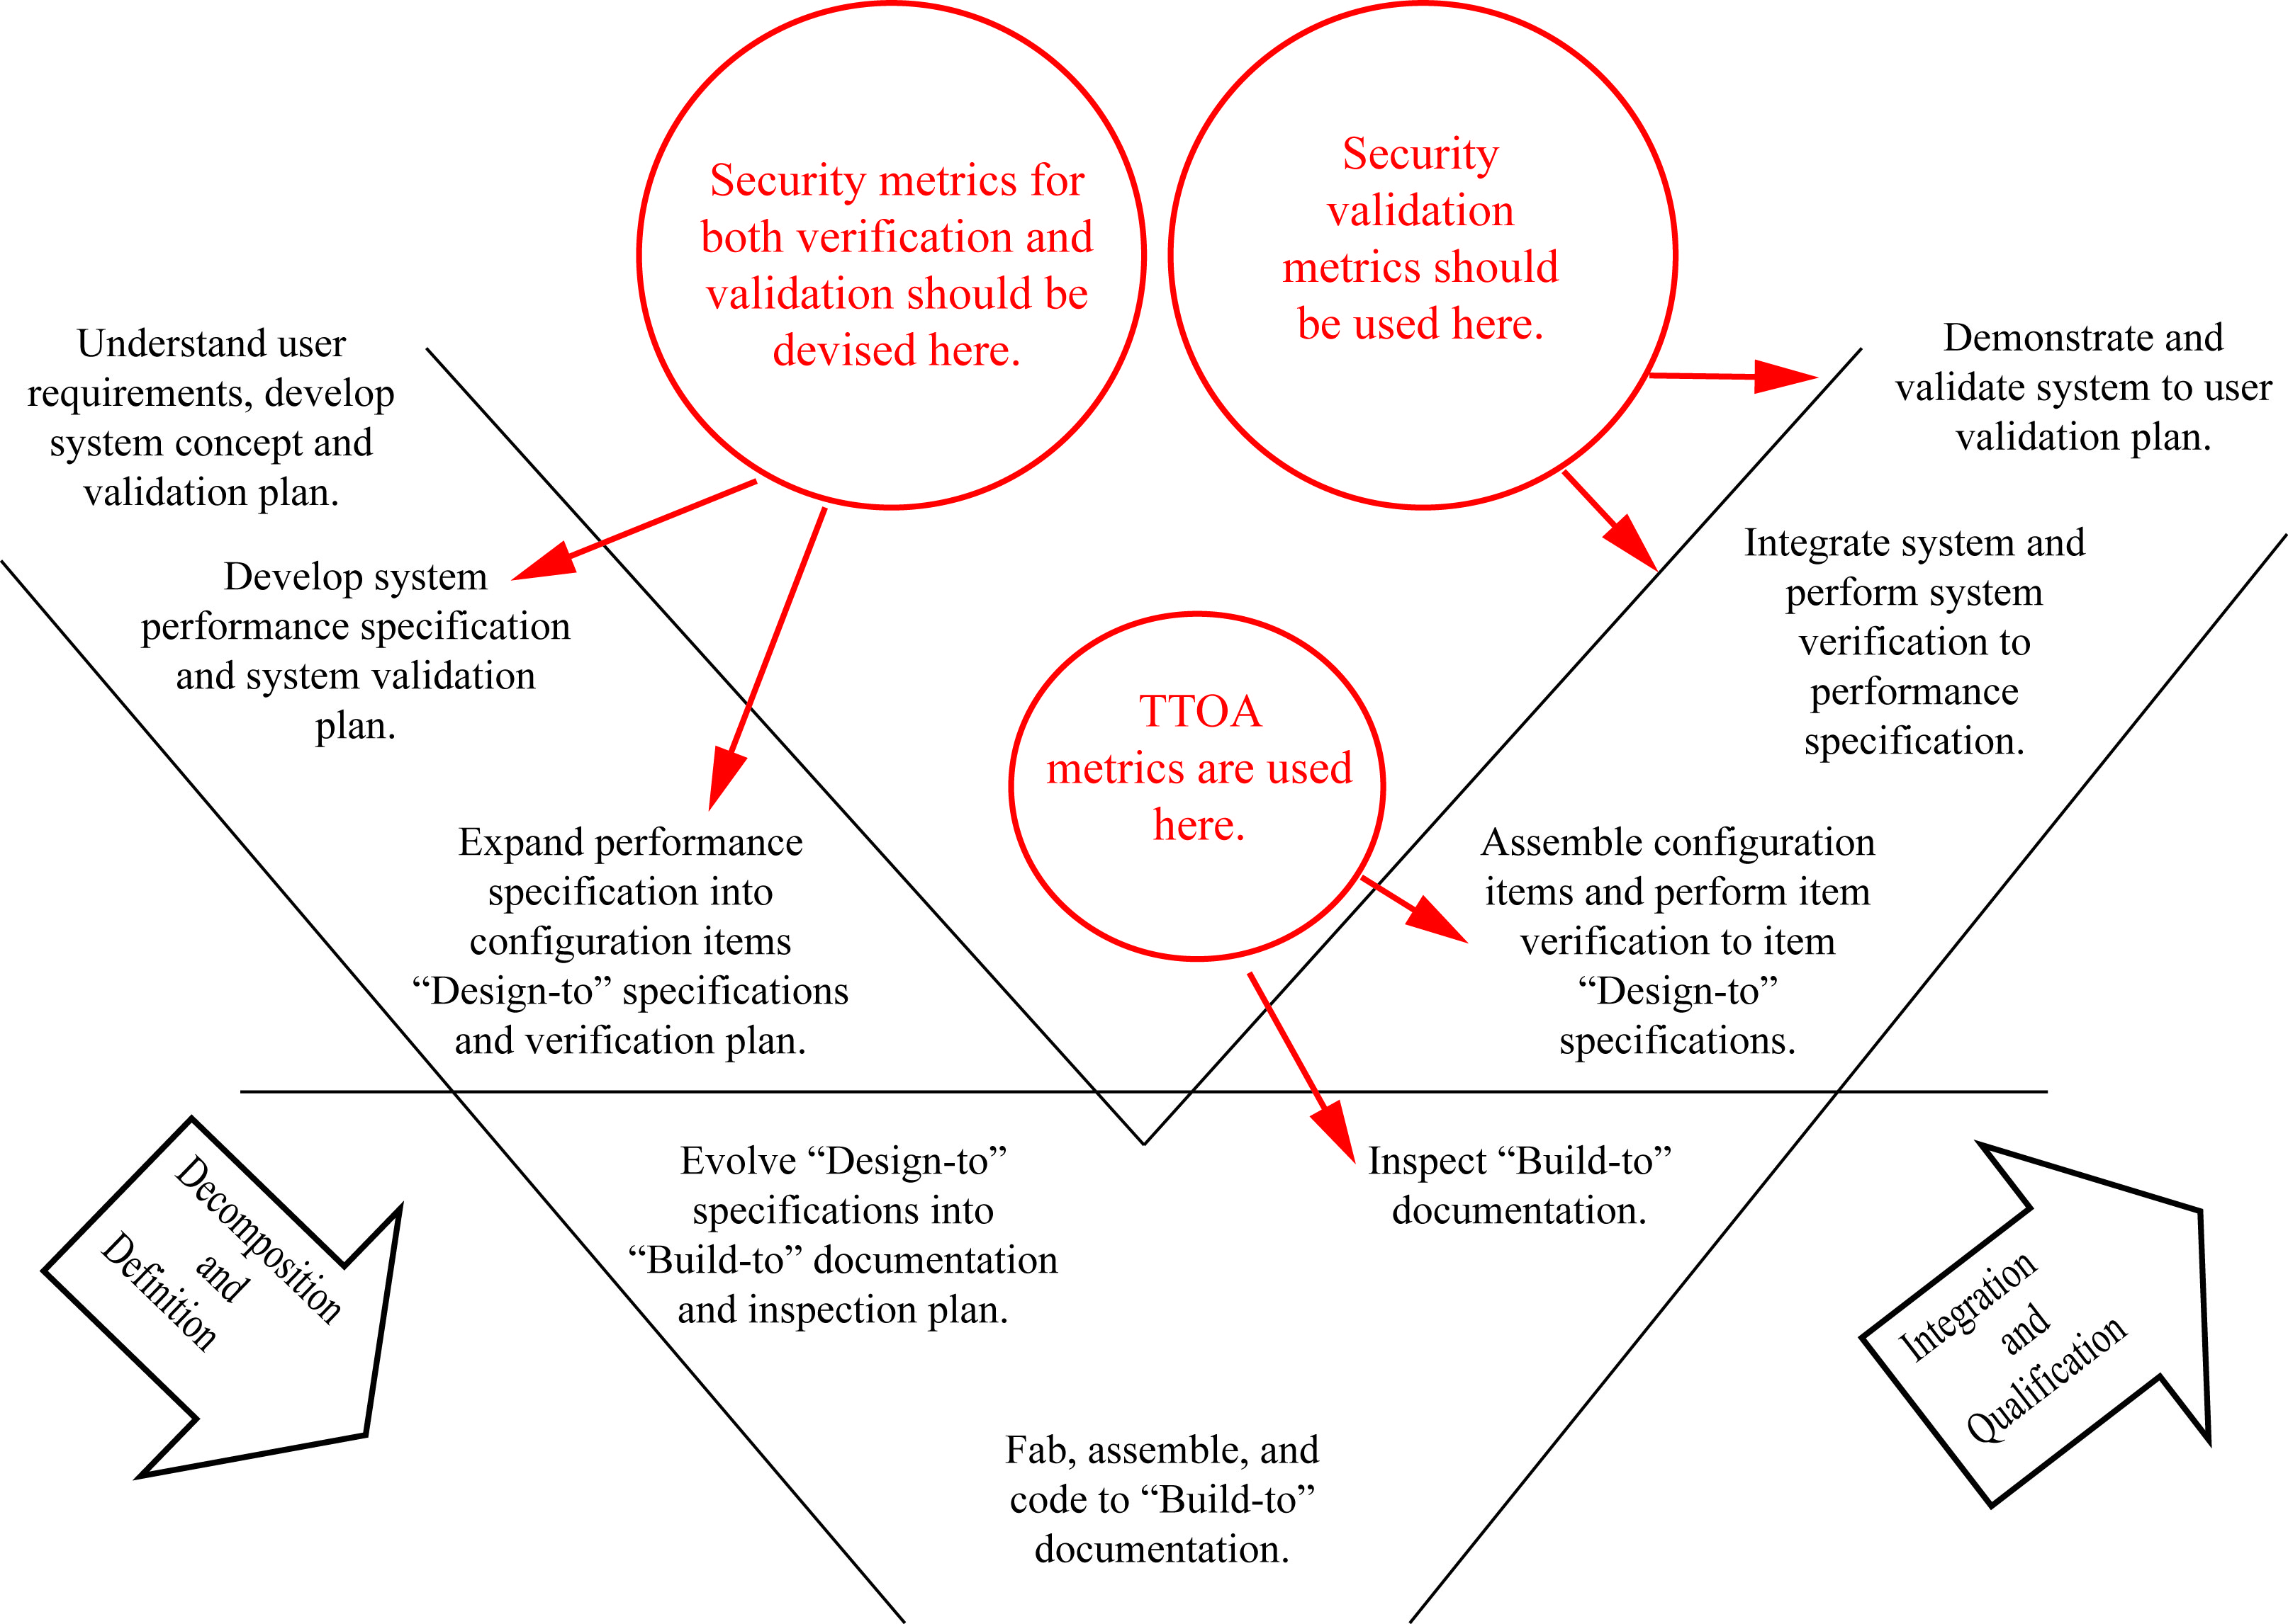
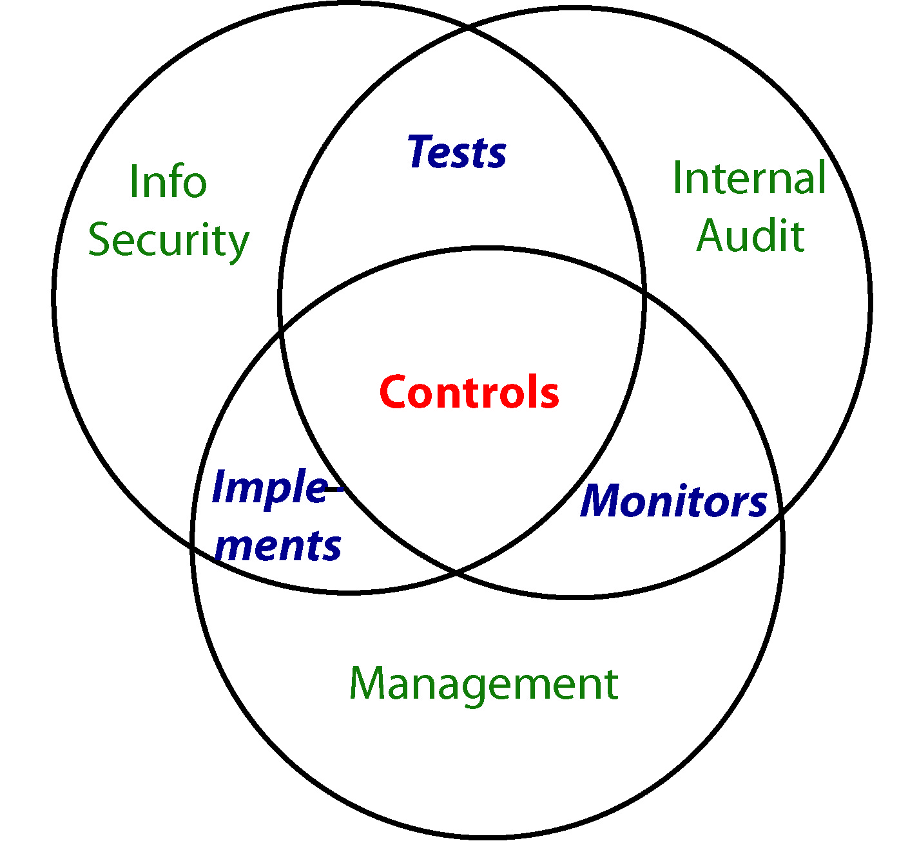
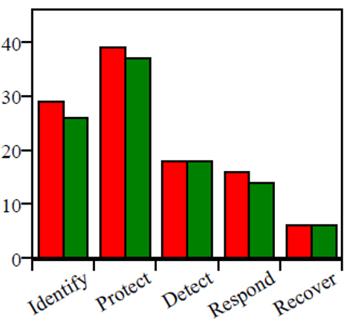
What Does Good Cybersecurity Look Like?
Source: https://cybervisuals.org/

Slide 6
Where does “good” criteria come from?
Where does “good” criteria come from?
Although Cybersecurity has many metrics,* unfortunately, there is not yet an authoritative catalog like this one and unlikely to be one for some time to come.
*See: “The History of Cybersecurity Metrics” at:
https://www.cerias.purdue.edu/news_and_events/events/security_seminar/details/index/7pqk4m683a9hhdjmvdf7uecb6j
Source: https://www.mosaic.tech/financial-metrics
©Decision Framework Systems

Slide 7
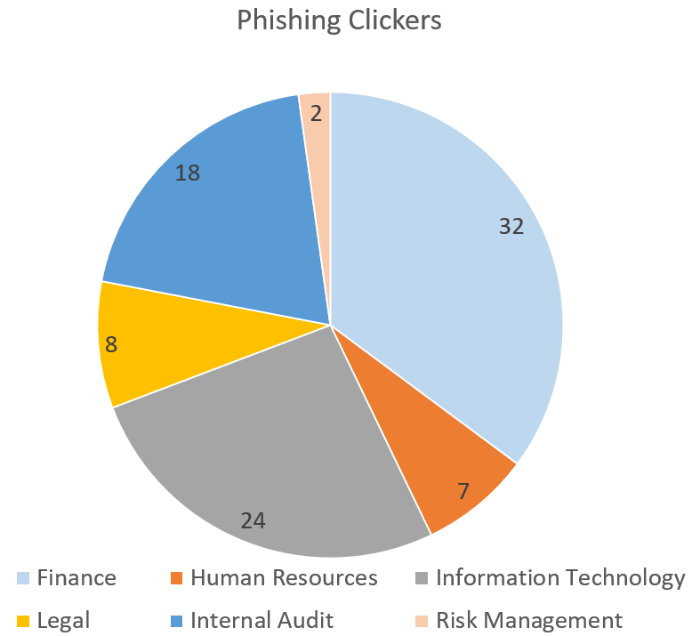
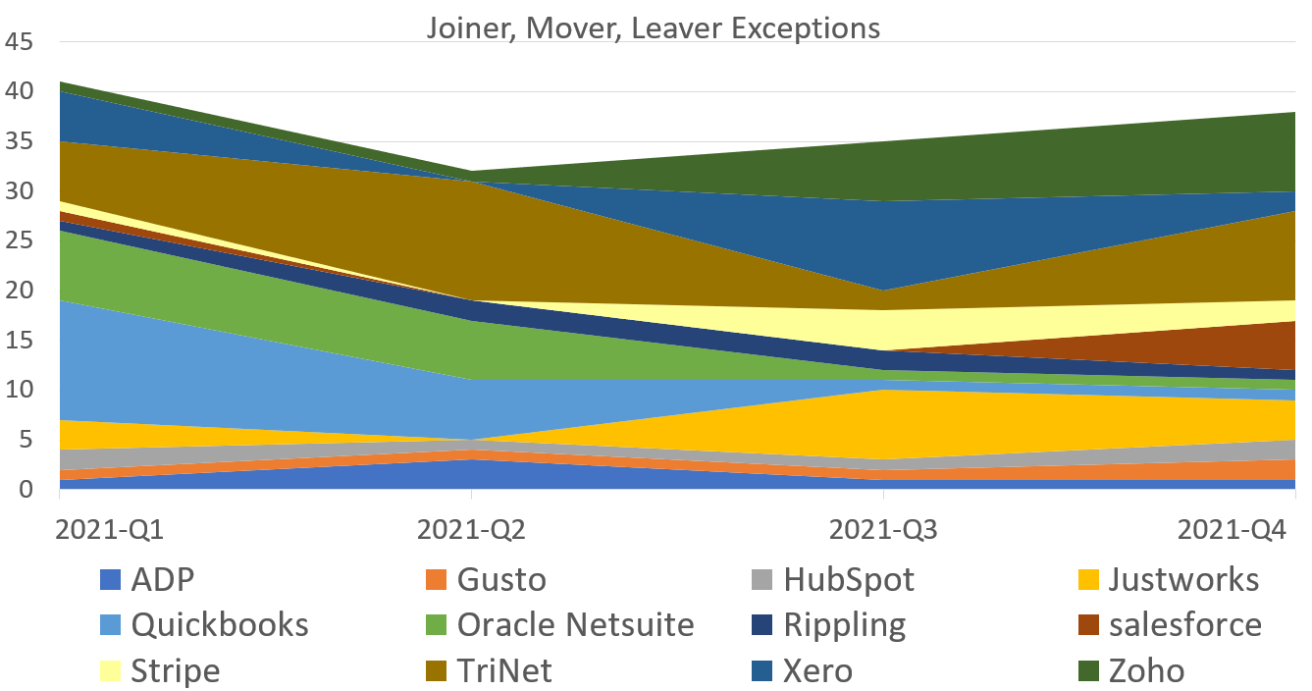
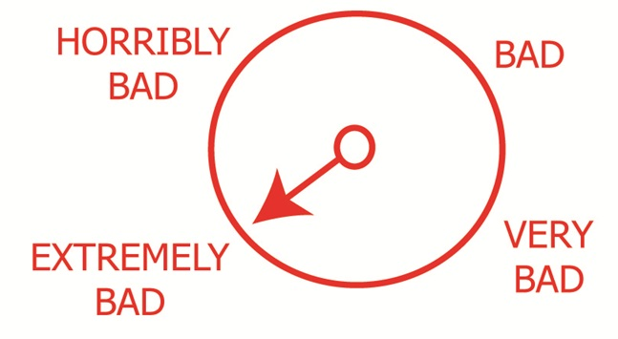
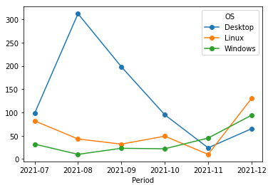
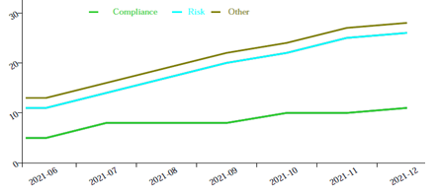
What Bad Looks like
Successful Phish Attacks by Percentage
of Staff in Organization
Joiners, Movers, Leavers Access Control Mistakes
10%
22%
64%
30%
16%
14%
A “Badness-ometer”
– provided by Gary McGraw in Software Security
Vulnerabilities Not Patched Within Target Timeframes
Significant Cybersecurity Issues
A “Badness-ometer”
– provided by Gary McGraw in Software Security
©Decision Framework Systems

Slide 8
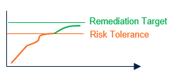
Good Requires Objective Criteria For Evaluation
Moving from As-Is to To-Be should be in the form of milestones that demonstrate the To-Be state is achieved.
Both verification and validation metrics are required to demonstrate repeatability.
NIST-CSF Guidance on Tier Evaluation for Tier 3: Repeatable
Risk Management Processes: Tier 3 organizations have formally approved risk management practices and are expressed as policy. These practices are regularly updated based on changes in business requirements and changing threat landscape.
Integrated Risk Management Program: Tier 3 organizations have an organization-wide approach to managing cybersecurity risk. Risk-informed policies, processes, and procedures are defined and implemented and reviewed. There are methods in place to consistently respond effectively to changes in risk, and personnel possess the knowledge and skills to perform their roles. Senior cybersecurity and business-side executives communication regularly regarding cybersecurity risk.
External Participation: Tier 3 organizations understand their role in the ecosystems and contribute to the broader understanding of risks. They collaborate with other entities regularly that coincide with internally generated information that is shared with other entities. These organizations are aware of the risks associated with their supply chains and act formally on those risks, including implementing written agreements to communicate baseline requirements, governance structures, and policy implementation and monitoring.
NIST-CSF, Framework for Improving Critical Infrastructure Cybersecurity, Version 1.1, April 2018, https://nvlpubs.nist.gov/nistpubs/CSWP/NIST.CSWP.04162018.pdf

Slide 9
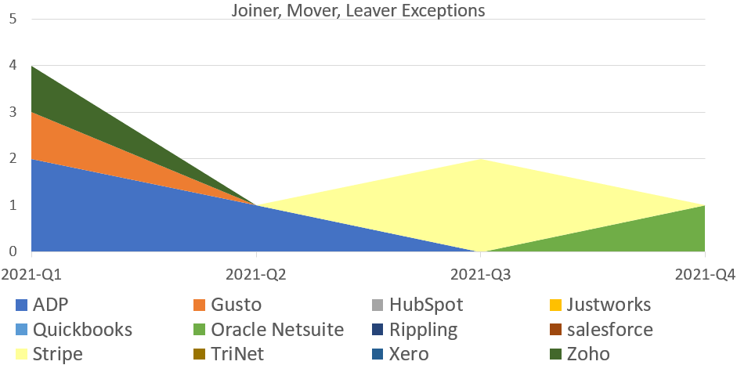
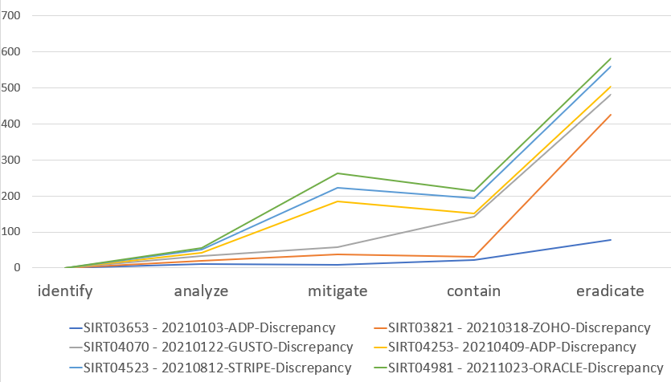
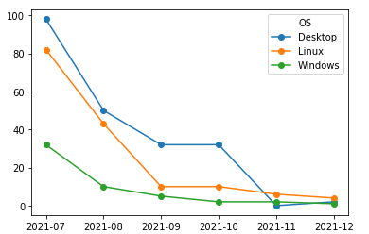
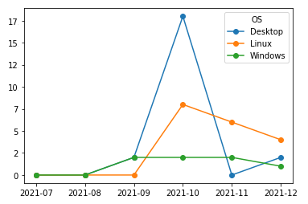
What Better Looks like
Time to Respond to Access Control Discrepancies (Minutes)
Joiners, Movers, Leavers Access Control Mistakes
Deferred Issues
Stack by types
No IA or reg issues
Vulnerabilities attested by Accountable Owner to have compensating controls, allowing for deferral of patch date within a new target timeframe
Vulnerabilities Not Patched Within Target Timeframes
Target One-to-One Correlation
©Decision Framework Systems

Slide 10
Good Requires Coordination of Effort Toward Common Goals
*
Consistency
Risk Appetite: Risk appetite is a qualitative description of the amount of risk a firm is willing to accept with respect to a given category of events.
Cybersecurity Policy: Mandates that provide a methodology for managing cybersecurity risks within appetite.
Process: How people work together to implement policy.
CEO/President
Appetite
These documents build on each other.
CISO
Policy
Awareness and directives at higher levels drive awareness and corresponding activities at lower levels.
Cybersecurity Business Alignment
Process
Security Architecture
Standards
Directives for technical configurations
Staff with Cyber Responsibilities
Procedures
Step-by-Step “How-to” instructions
All Staff
Guidelines
Advice for complying with policy
*To meet good criteria, must be consistent with legal obligations and contractual requirements!
©Decision Framework Systems

Slide 11
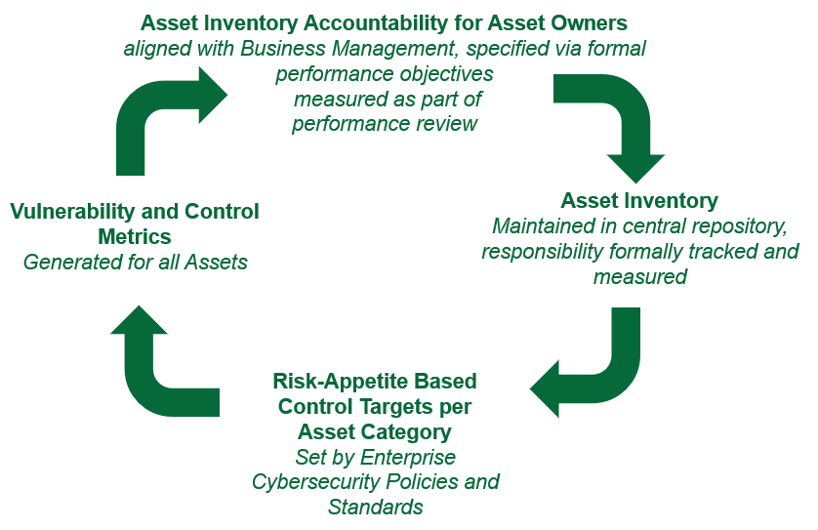
Asset Inventory
Asset Inventory Accountability for Asset Owners
aligned with Business Management, specified via formal performance objectives
measured as part of
performance review
Vulnerability and Control Metrics
Generated for all Assets
Asset Inventory
Maintained in central repository, responsibility formally tracked and measured
Risk-Appetite Based Control Targets per Asset Category
Set by Enterprise
Cybersecurity Policies and Standards
©Decision Framework Systems

Slide 12
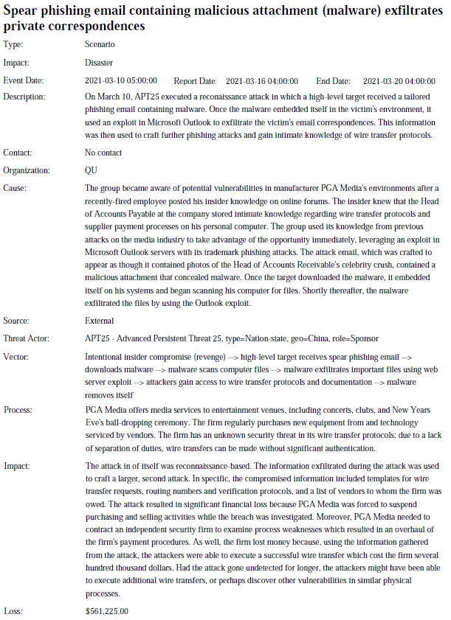
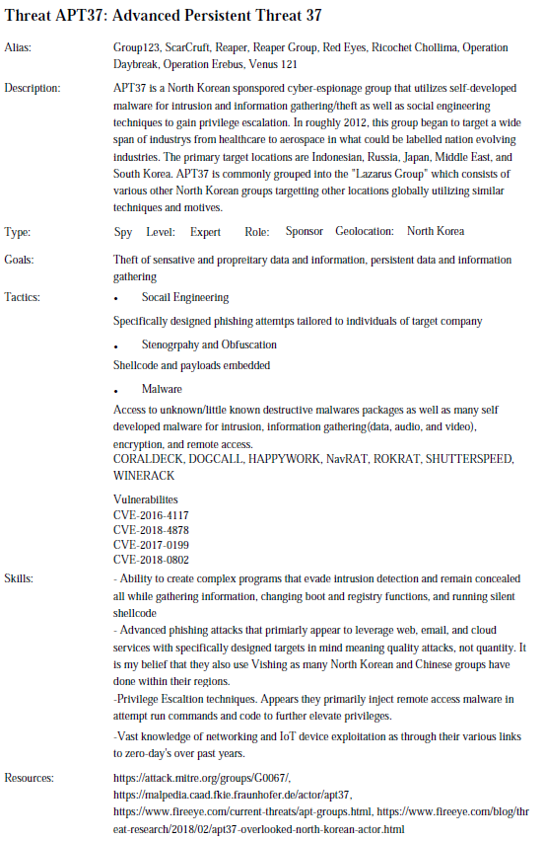
Threat-based Risk Register
Custom Risk Hierarchy:
Cybersecurity
|---Business Disruption
| |---Data Integrity Attack
| |---Denial of Service
|---Malware Infection
|---Insider Threat
| |---Phishing Email
| |---Intentional Insider Threat
| |---Accidental Insider Threat
|---Data Loss
| |---Loss of Personal Records
| |---Lost or Stolen Credentials
|---Misconfigurations
|---Advanced Persistent Threat
©Decision Framework Systems

Slide 13
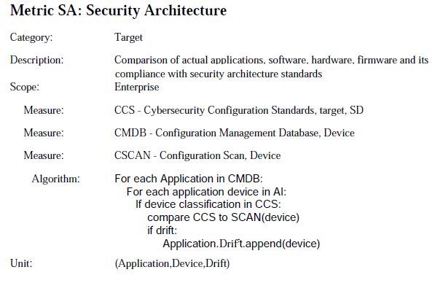
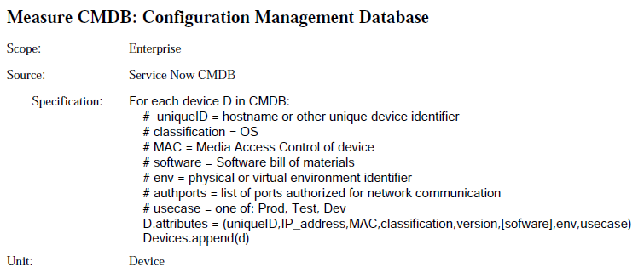
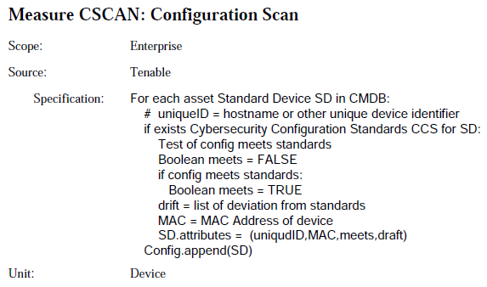
Cybersecurity Architecture
Technology Device Inventory
©Decision Framework Systems

Slide 14
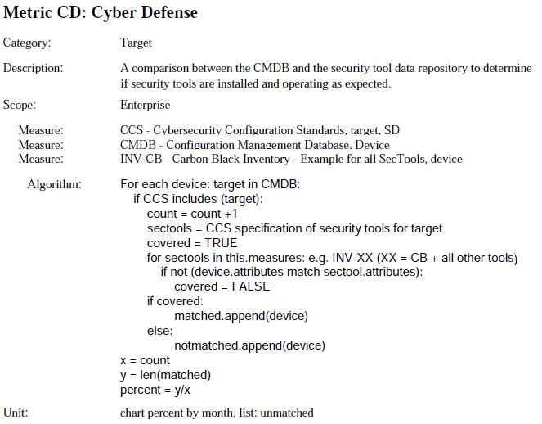
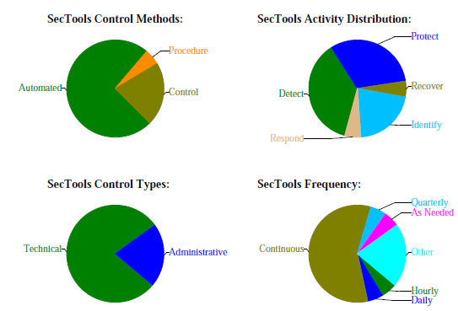
Cybersecurity Control Inventory
Representative Example for coverage measure
©Decision Framework Systems

Slide 15
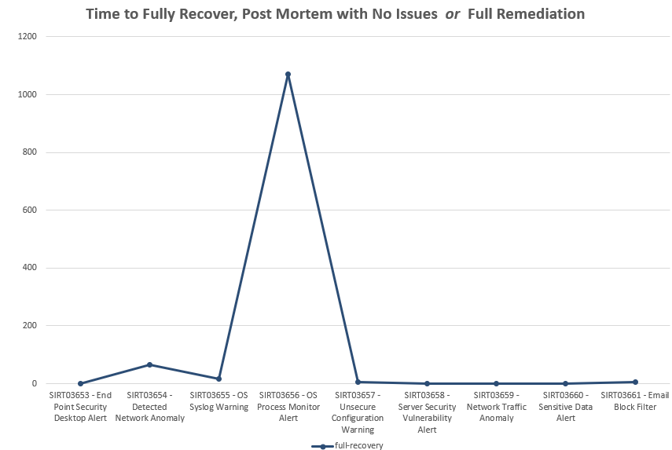
Cybersecurity Operations
Example Metric: Incident Time to Close (see earlier example for Access Control) as well as full recovery for incidents of high impact
Measures should be taken from official system of record:
Example Metric: Open Incident Overview by Impact and Type
©Decision Framework Systems

Slide 16
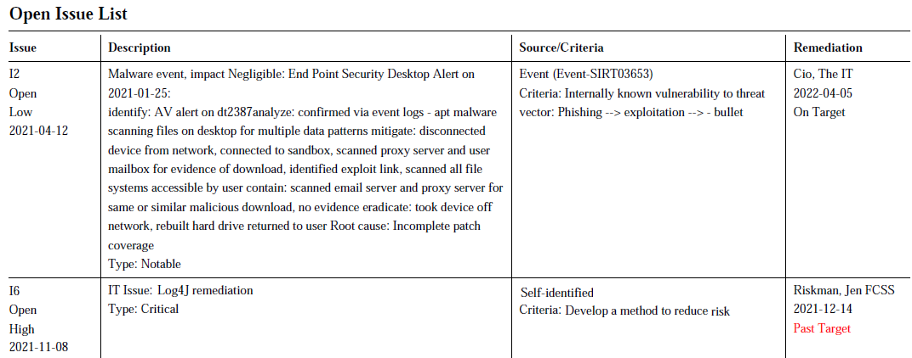
Issue Register
©Decision Framework Systems

Slide 17
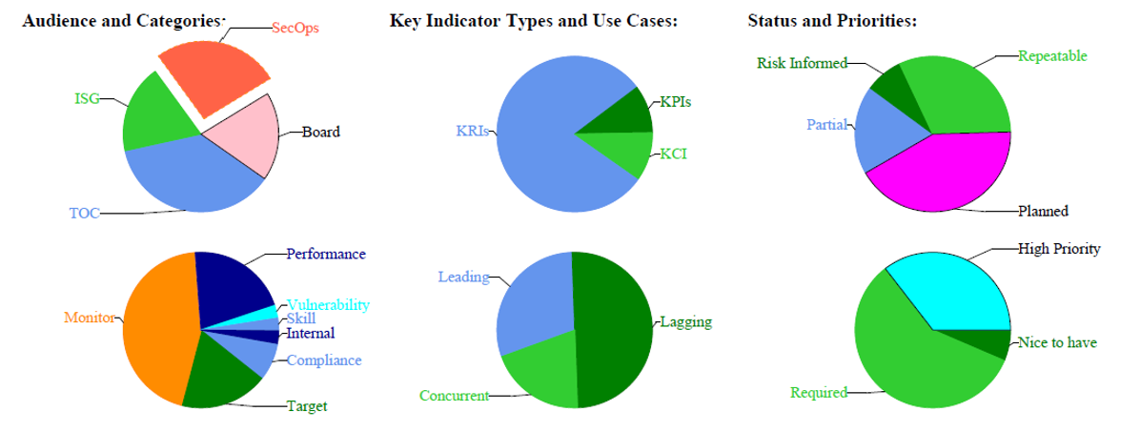
Metrics on Metrics
©Decision Framework Systems

Slide 18
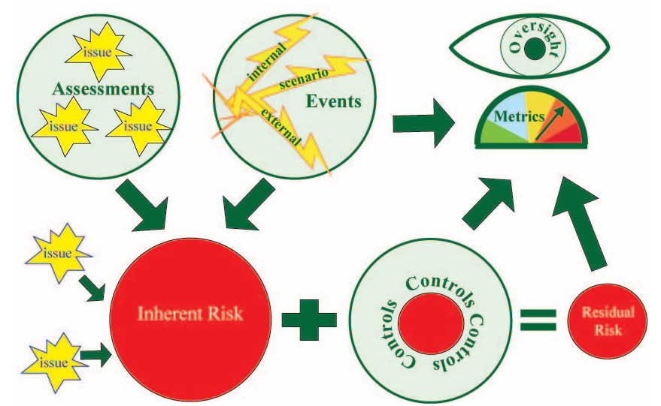
Risk Frameworks Allow Quantitative Data Analysis
©Decision Framework Systems

Slide 19
Thank you!
Jennifer Bayuk
Decision Framework Systems, Inc.
TAG-Cyber, Inc

