Slide 2
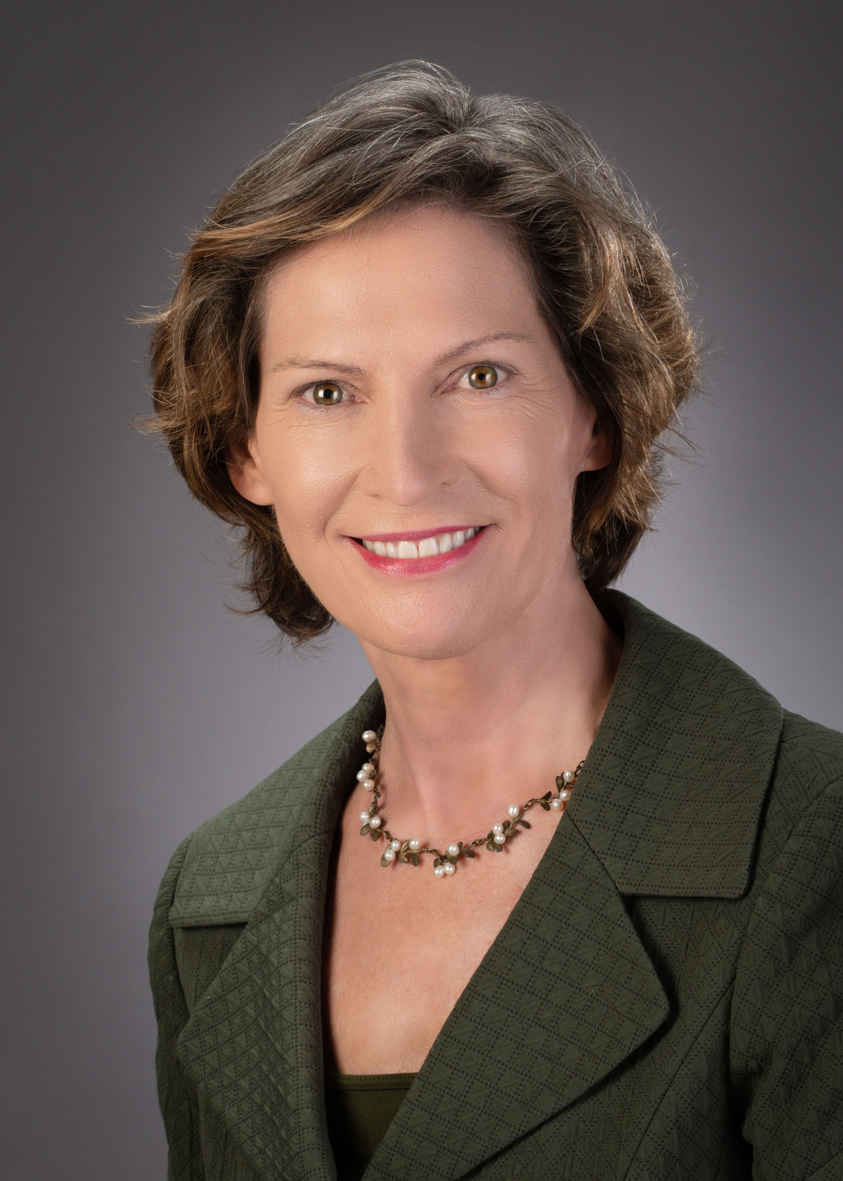
Palestrante
Experienced in a wide variety of private security positions, including Wall Street Chief Information Security Officer, Financial Services Internal Audit, Global Bank Operational Risk Management, Academic, and Big 4 Information Systems Risk.
BS in Computer Science and Philosophy, MS in Computer Science, PhD in Systems Engineering.
Author of multiple textbooks and articles on security management topics.

Slide 3
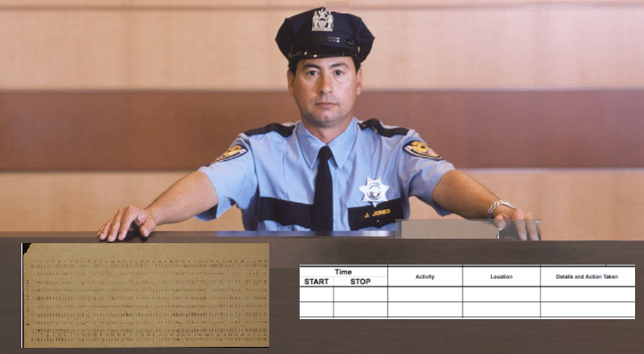
User Terminal
ACLs
Entitlements
Mainframe
Time Sharing or Bulletin Board Service
LAN
User Workstation
::::::
Firewall
Hardened
Server
Farm
App
Servers
Email
::::::
Router
232134
Firewall
Internet
Web
Servers
ARPANET
Token Admin
Router
External Servers
Physical Perimeter

Slide 4
Identity
Mgmt
Certificate
Authority
::::::
USB
User Terminal
Firewall
Info Security Admin
ACLs
Entitlements
VPN
Online Services and
Outsourcing Arrangements
Mainframe
Time Sharing or Bulletin Board Service
LAN
Internet
User Workstation
Threats
::::::
Firewall
Clients
CERTS
CERTS
Internet
VPN
Hardened
Server
Farm
App
Servers
Email
::::::
Router
232134
CERTS
Firewall
Web
Servers
Internet
Token Admin
Proxy
Server
IDS
Router
External Servers
Circa 1998
Physical Security

Slide 5
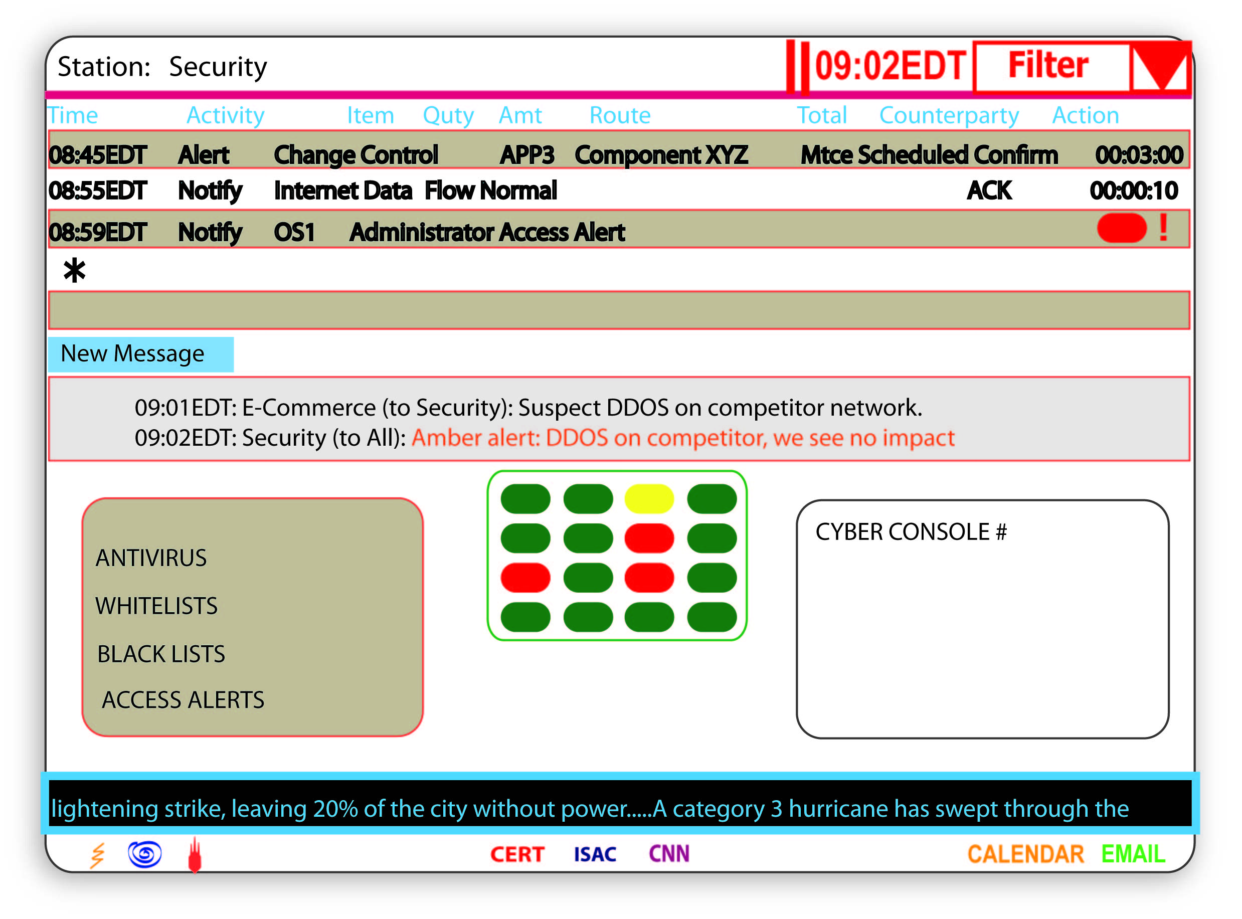
Identity
Mgmt
AntiVirus
Mgt
Certificate
Authority
::::::
USB
SIM
Policy Servers
Firewall
Security Operations
Info Security Admin
ACLs
Entitlements
VPN
Online Services and
Outsourcing Arrangements
Mainframe
LAN
User Workstation
Internet
Threats
::::::
Firewall
Clients
CERTS
CERTS
Internet
VPN
Hardened
Server
Farm
App
Servers
Email
::::::
Router
232134
CERTS
Firewall
Web
Servers
Proxy
Server
IDS
Token Admin
IPS
Router
External Servers
Circa 2001
Physical Security

Slide 6
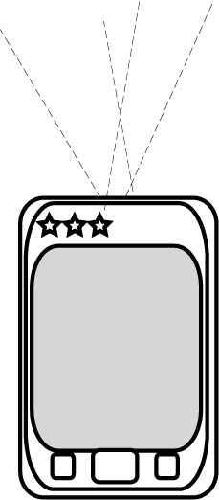
Identity
Mgmt
AntiVirus
Mgt
Certificate
Authority
::::::
Key Management
USB
USB
SIM
Policy Servers
Firewall
Security Operations
ACLs
Entitlements
DATA
SHARES
VPN
Online Services and
Outsourcing Arrangements
Mainframe
LAN
User Workstation
Internet
Threats
::::::
Firewall
keys on
chips
Clients
VPN
Wireless
WAFW
Content
Filters
CERTS
CERTS
Internet
VPN
Hardened
Server
Farm
App
Servers
Email
::::::
Router
232134
CERTS
Firewall
Web
Servers
Proxy
Server
Content
Filters
Internal Labs or Scanning Services
Token Admin
IPS
Router
External Servers
Circa 2005
Physical Security

Slide 7
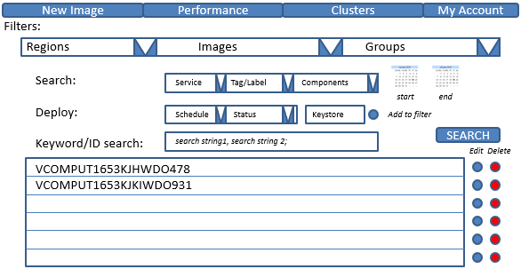
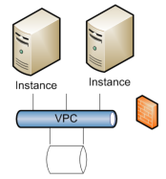
::::::
Cloud Access
Firewall
Secure Cloud
Configuration
& Monitoring
Identity
Mgmt
AntiVirus
Mgt
Certificate
Authority
::::::
Key Management
USB
SIM
Cloud Vendor
Policy Servers
Firewall
logs &
stats
Security Operations
ACLs
Entitlements
DATA
SHARES
VPN
VMM
MS
MS
Online Services and
Outsourcing Arrangements
Mainframe
LAN
User Workstation
MS
MS
Internet
Threats
::::::
Firewall
keys on
chips
Clients
VPN
Wireless
WAFW
Content
Filters
CERTS
CERTS
Internet
VPN
Hardened
Server
Farm
App
Servers
Email
::::::
Router
232134
CERTS
Firewall
Scoring
Services
Web
Servers
Proxy
Server
Content
Filters
IPS
Internal Labs or Scanning Services
Token Admin
Router
::::::
Cloud Connect
Firewall
External Servers
Circa 2008
Physical Security

Slide 8
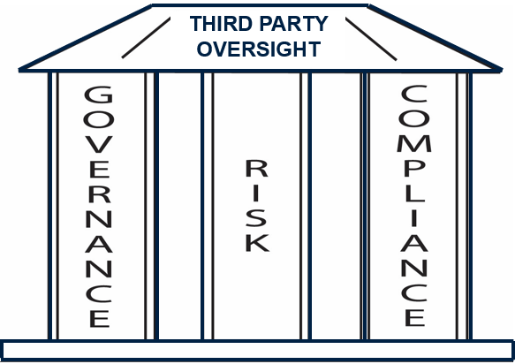
::::::
Cloud Access
Firewall
Secure Cloud
Configuration
& Monitoring
Identity
Mgmt
AntiVirus
Mgt
Certificate
Authority
::::::
Key Management
USB
SIM
Cloud Vendor
Policy Servers
Firewall
logs &
stats
Security Operations
ACLs
Entitlements
DATA
SHARES
VPN
VMM
MS
MS
Online Services and
Outsourcing Arrangements
Mainframe
LAN
User Workstation
MS
MS
Internet
Threats
::::::
Firewall
keys on
chips
Clients
VPN
Wireless
WAFW
Content
Filters
CERTS
CERTS
Internet
VPN
Hardened
Server
Farm
App
Servers
Email
::::::
Router
232134
CERTS
Firewall
Scoring
Services
Web
Servers
Proxy
Server
Content
Filters
IPS
Internal Labs or Scanning Services
Token Admin
Router
::::::
Cloud Connect
Firewall
External Servers
Circa Now
Physical Security

Slide 9
Obrigado(a)
jennifer@bayuk.com
www.bayuk.com

